Slide 1

CS552: Computer Graphics
Lecture 13: Raster Graphics and Scan Conversion

Slide 2
Recap
Viewing pipeline
Model coordinate
World coordinate
View coordinate
Normalized coordinate
Device coordinate
Transformation
2D
3D
Homogeneous
Cliping
2D
3D

Slide 3
Objective
After completing this lecture students will be able to
Derive mathematical expression for drawing lines between two points
Write programs to implement line drawing algorithm

Slide 4
2D Graphics Pipeline
Clipping
Object
World Coordinates
Applying
world window
Object
subset
window to
viewport
mapping
Simple 2D Drawing Pipeline
Display
Rasterization
Object
Screen coordinates

Slide 5
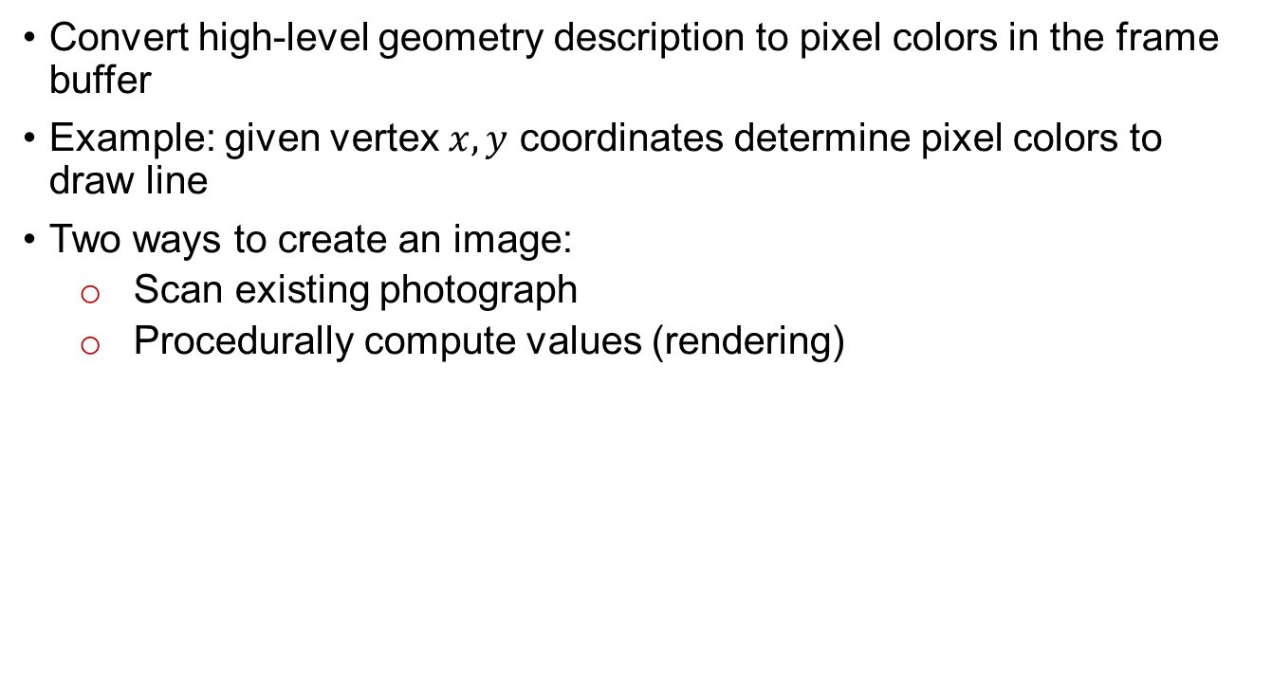
Rasterization (Scan Conversion)
Convert high-level geometry description to pixel colors in the frame buffer
Example: given vertex $x,y$ coordinates determine pixel colors to draw line
Two ways to create an image:
Scan existing photograph
Procedurally compute values (rendering)
Viewport Transformation
Rasterization

Slide 6
Rasterization
A fundamental computer graphics function
Determine the pixels’ colors, illuminations, textures, etc.
Implemented by graphics hardware
Rasterization algorithms
Lines
Circles
Triangles
Polygons

Slide 7
Rasterization Operations
Drawing lines on the screen
Manipulating pixel maps (pixmaps): copying, scaling, rotating, etc
Compositing images, defining and modifying regions
Drawing and filling polygons
Aliasing and antialiasing methods

Slide 8
Line drawing algorithm
Programmer specifies (x,y) values of end pixels
Need algorithm to figure out which intermediate pixels are on line path
Pixel (x,y) values constrained to integer values
Actual computed intermediate line values may be floats
Rounding may be required. E.g. computed point
(10.48, 20.51) rounded to (10, 21)
Rounded pixel value is off actual line path (jaggy)

Slide 9
Line Drawing Algorithm
8
7
6
5
4
3
2
1
Line: (3,2) -> (9,6)
?
Which intermediate
pixels to turn on?
0 1 2 3 4 5 6 7 8 9 10 11 12

Slide 10
DDA Line Drawing Algorithm (Case a: m < 1)
x = x0 y = y0
Illuminate pixel (x, round(y))
(x1,y1)
x = x0 + 1
y = y0 + 1 * m
Illuminate pixel (x, round(y))
x = x + 1
y = y + 1 * m
Illuminate pixel (x, round(y))
…
Until x == x1
(x0, y0)

Slide 11
DDA Line Drawing Algorithm (Case b: m > 1)
x = x0 y = y0
(x1,y1)
Illuminate pixel (round(x), y)
y = y0 + 1
x = x0 + 1 * 1/m
Illuminate pixel (round(x), y)
y = y + 1
x = x + 1 /m
Illuminate pixel (round(x), y)
…
(x0,y0)
Until y == y1

Slide 12
DDA Line Drawing Algorithm Pseudocode
compute m;
if m < 1:
{
float y = y0; // initial value
for(int x = x0;x <= x1; x++, y += m)
setPixel(x, round(y));
}
else // m > 1
{
float x = x0; // initial value
for(int y = y0;y <= y1; y++, x += 1/m)
setPixel(round(x), y);
}
Note: setPixel(x, y) writes current color into pixel in column x and row y in frame buffer

Slide 13
Line Drawing Algorithm Drawbacks
DDA is the simplest line drawing algorithm
Not very efficient (time consuming)
Round operation is expensive
Optimized algorithms typically used.
Integer DDA
E.g. Bresenham algorithm
Bresenham algorithm
Incremental algorithm: current value uses previous value
Integers only: avoid floating point arithmetic
midpoint version of algorithm

Slide 14
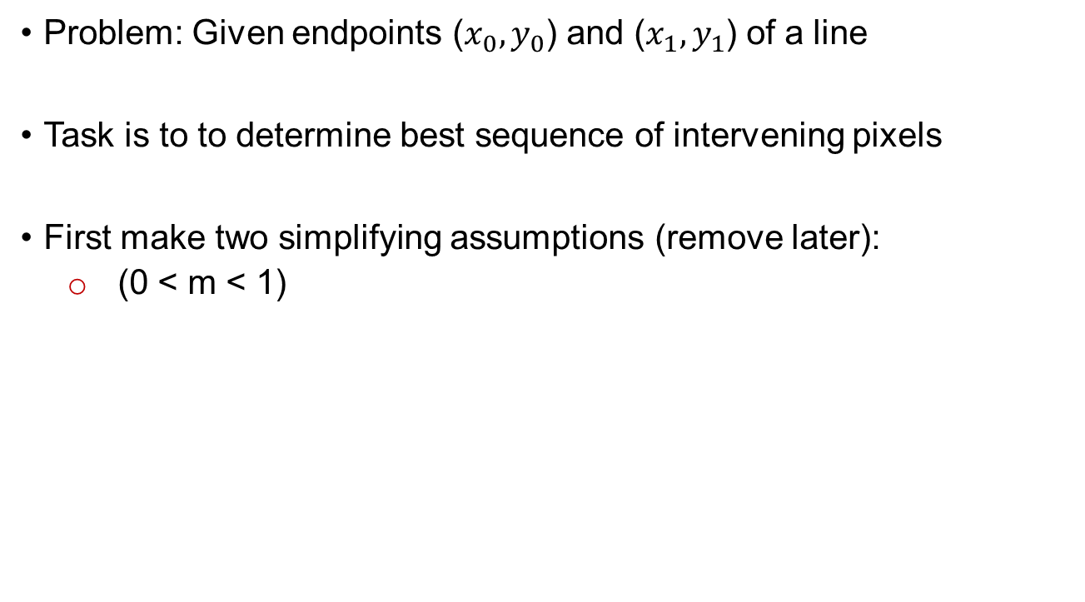
Bresenham’s Line-Drawing Algorithm
Problem: Given endpoints ($x_{0},y_{0}$) and ($x_{1},y_{1}$) of a line
Task is to to determine best sequence of intervening pixels
First make two simplifying assumptions (remove later):
(0 < m < 1)

Slide 15
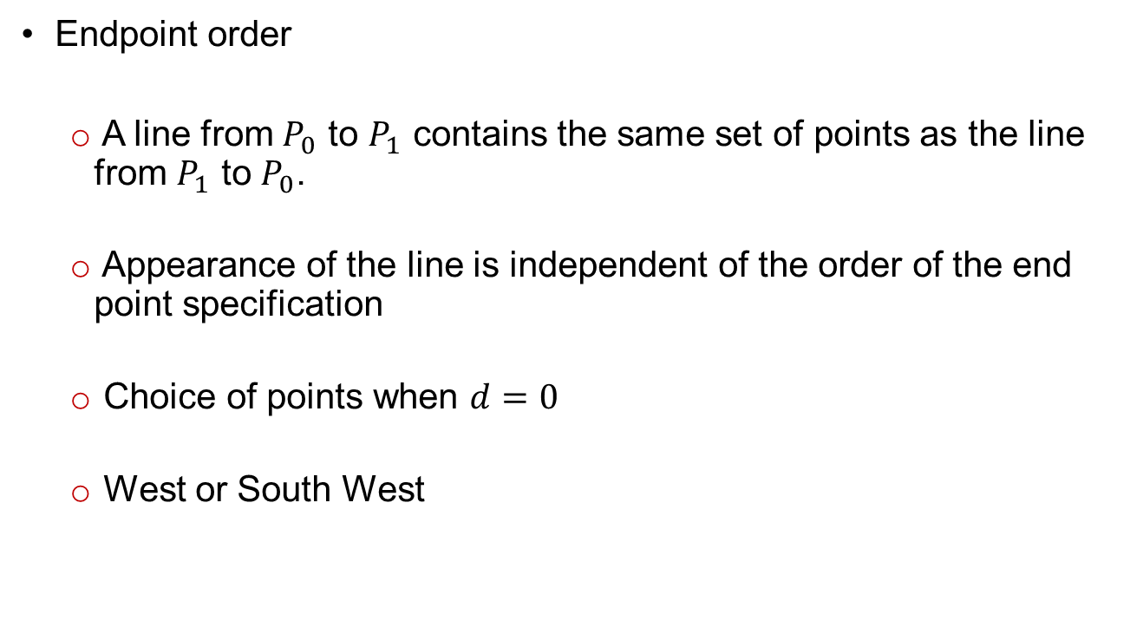
Additional Issues
Endpoint order
A line from $P_{0}$ to $P_{1}$ contains the same set of points as the line from $P_{1}$ to $P_{0}$.
Appearance of the line is independent of the order of the end point specification
Choice of points when $d=0$
West or South West

Slide 16
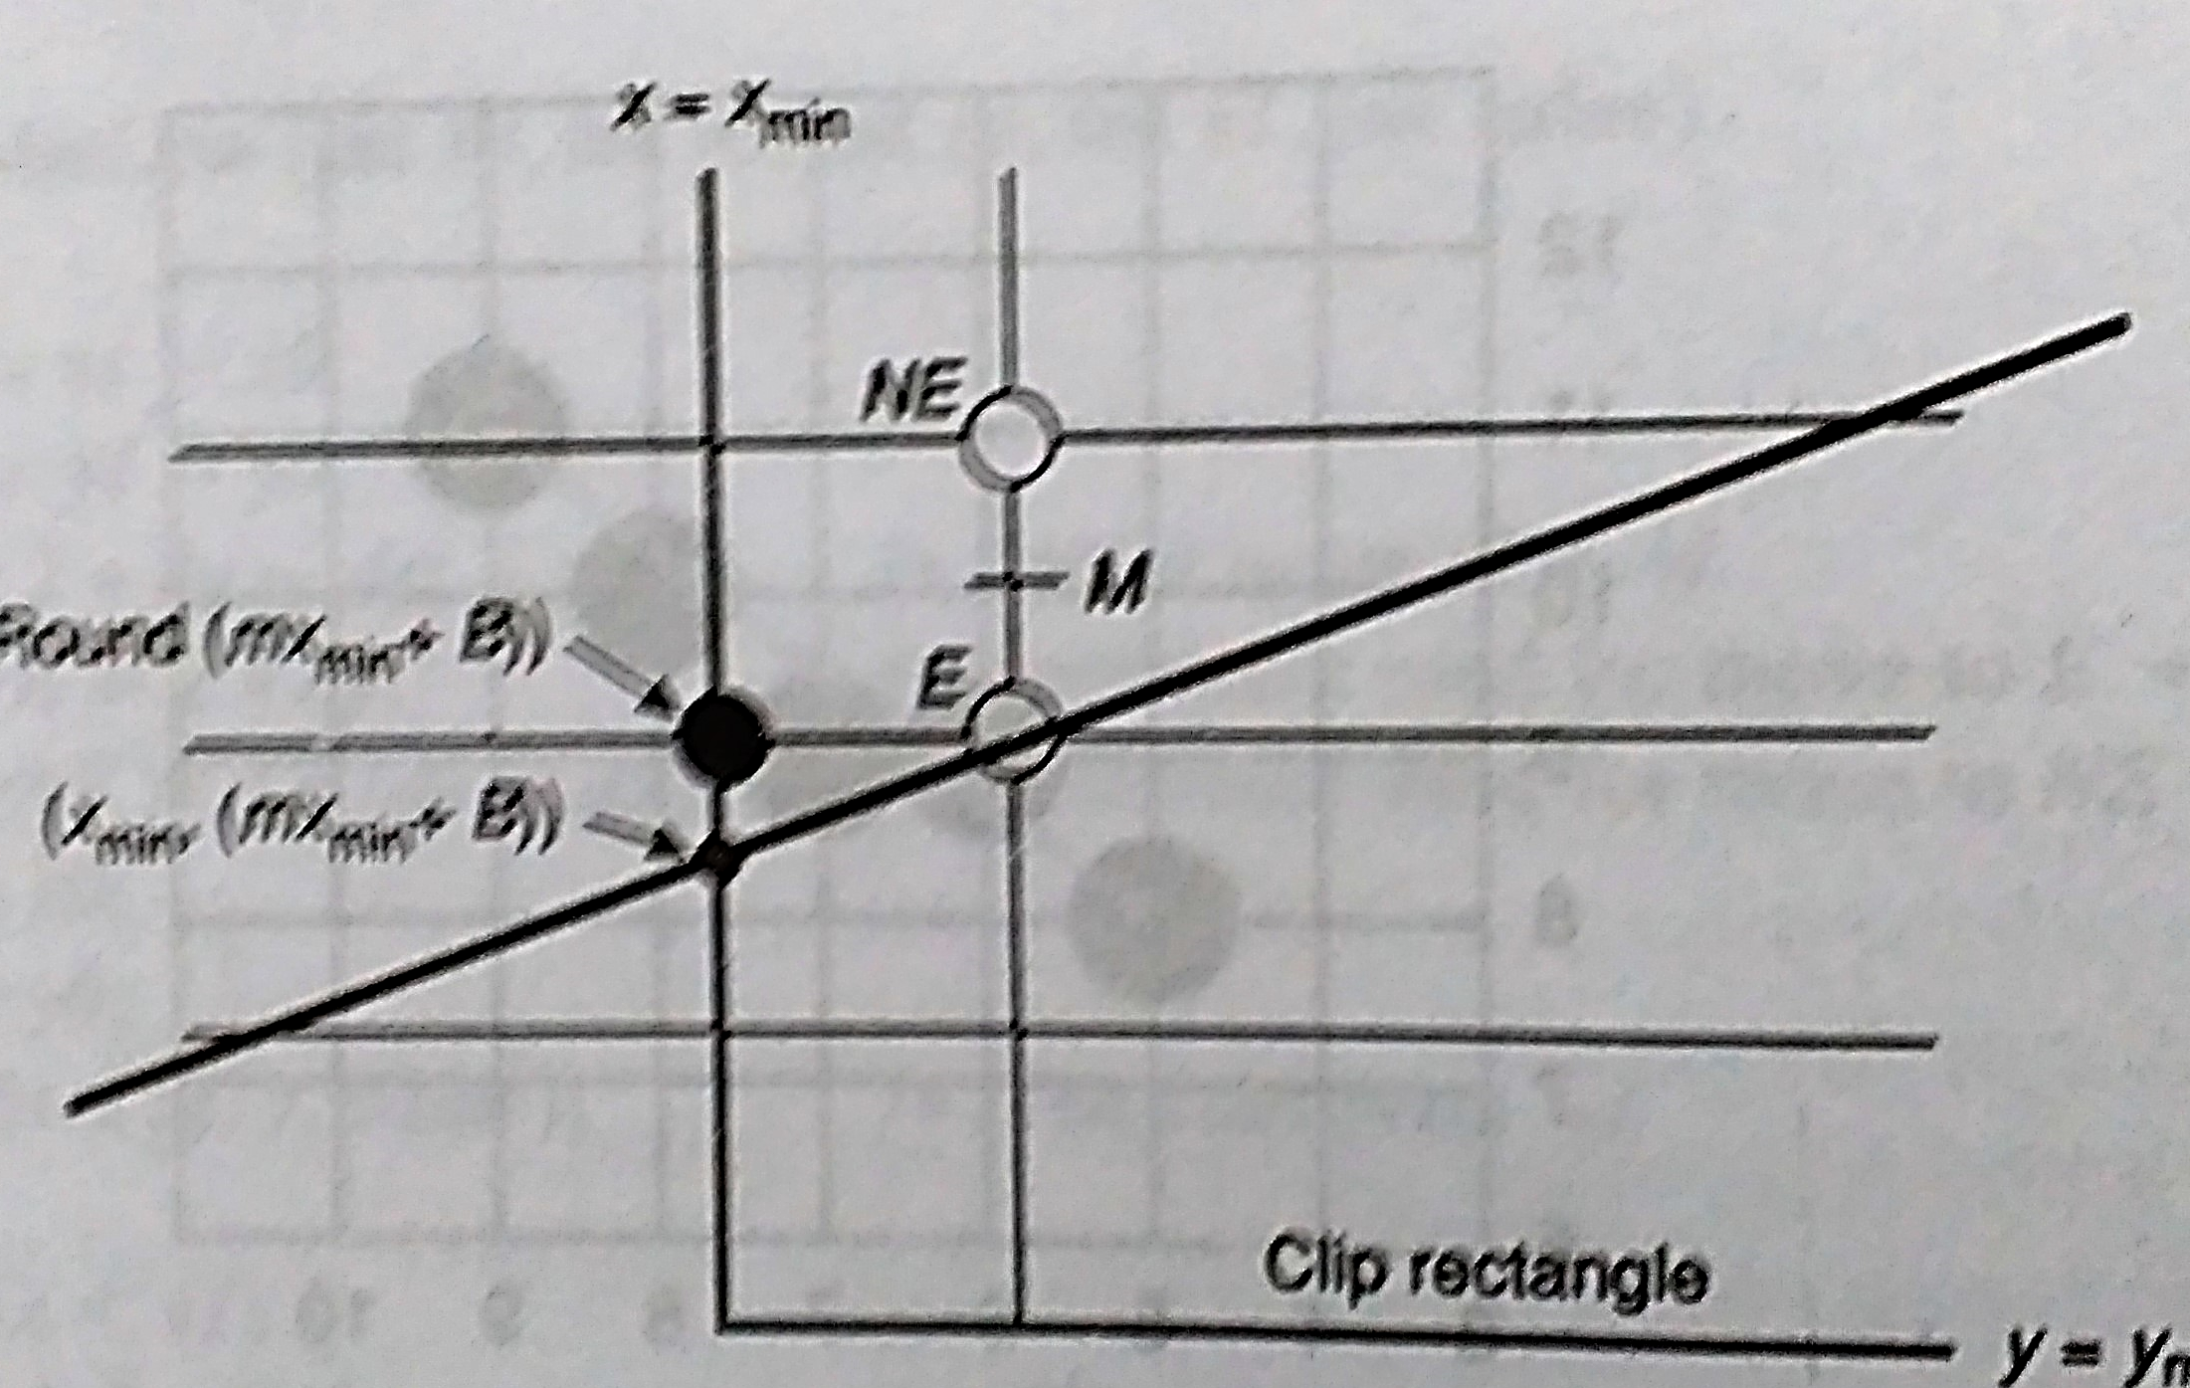
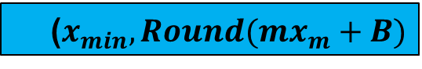
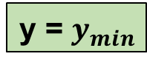
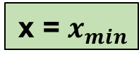
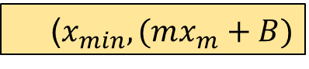
Additional Issues
Starting at the edge of a clip rectangle
Different slope ?
x = $x_{min}$
($x_{min},Round(mx_{m}+B)$
($x_{min},(mx_{m}+B)$
y = $y_{min}$

Slide 17
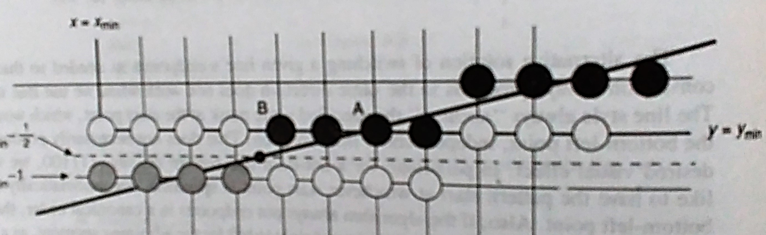
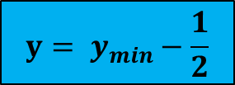
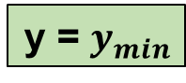
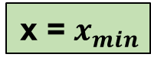
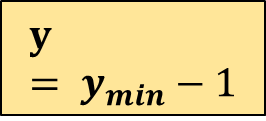
Additional Issues
Starting at the edge of a clip rectangle
Different slope ?
x = $x_{min}$
$$y= y_{min}−\frac{1}{2}$$
y = $y_{min}$
$$y= y_{min}−1$$

Slide 18
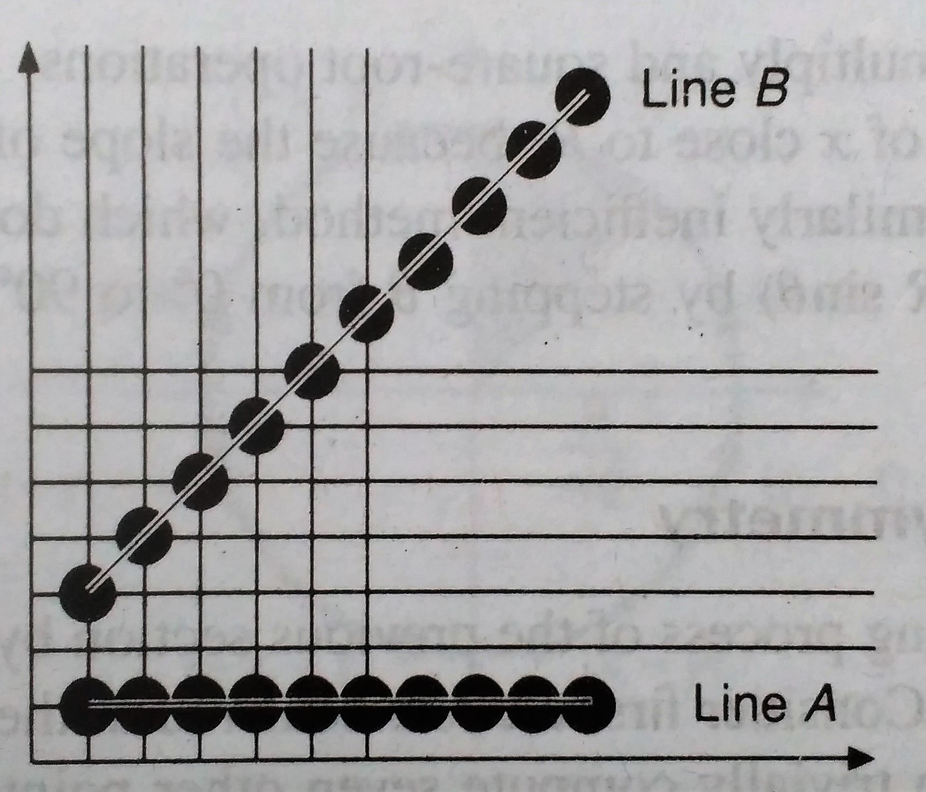
Additional Issues
Varying the intensity as a function of slope
Antialiasing
Line style

Slide 19
Thank you
Next Lecture: Scan converting Circle

